Slide 1
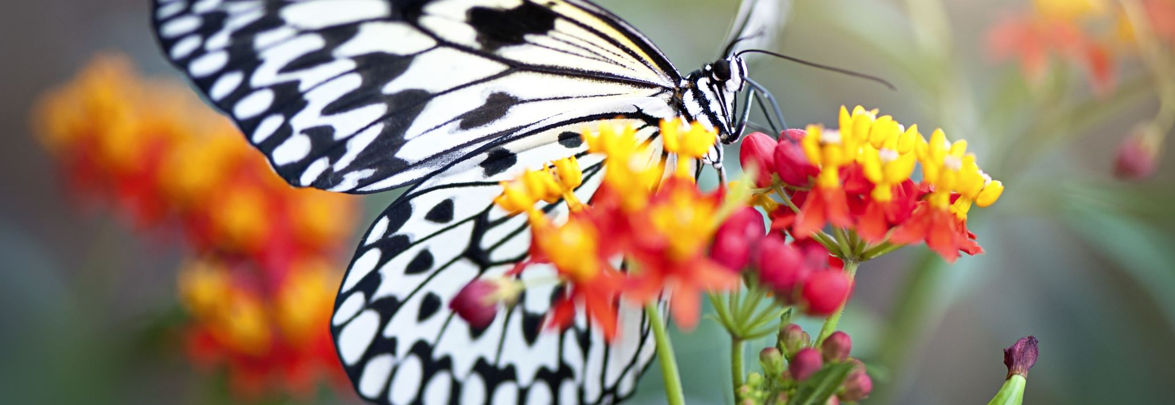
Land Trusts & the Road to 30% Next Steps

Slide 2
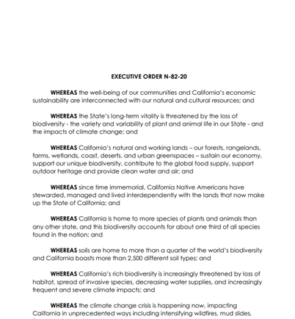
Executive Order N-82-20
goals to protect 30 percent of the state’s land and coastal waters by 2030 and enlisting California’s vast network of natural and working lands in the fight against climate change.
Notes:
In October 2020, Governor Newsom’s issued an Executive Order directing state agencies to advance strategies to conserve at least 30 percent of California’s land and waters by 2030 in a way that preserves biodiversity and natural resources, expands equitable access to outdoor lands and recreation, promotes nature-based solutions to address climate change, and maintains California’s economic prosperity.
This executive order will guide agency decisions for the duration of this Administration and likely well beyond – particularly when you consider that the Biden Administration has issues a similar order at the federal level and directed its agencies to identify how the federal government can meet this goal on the national level.
As background, the 30 by 30 goal came from leading scientists who looked at the current crises from extinctions and climate change. They determined that if humans are to have any hope of surviving, we will need to protect 50% of our planet’s lands and waters by 2050. The 30 by 30 goal is a step-down, interim goal.

Slide 3
How to Engage?
CHECK OUT:
https://www.californianature.ca.gov/pages/get-involved
ATTEND THE TOPICAL WORKSHOPS.
FILL OUT THE CCLT SURVEY: https://forms.gle/SQotGXNqbmLkXYzT7
Sept. 2nd Deadline for comment letters
Submit data to CA NATURE: https://survey123.arcgis.com/share/99022fdc5542478d81a1168c9fdb1b17
Review & Comment on the draft reports

Slide 4
CCLT Survey (initial results from 32 respondents)
All of the regions were represented with largest showing from the Sierra Nevada (31%), SF Bay Area (28%), Central Coast (26%), and LA (26%). The least represented were land trusts working in San Diego and the Inland Deserts.
Survey respondents have protected nearly 2.3 million acres of land, and they have another 2.1 million acres on deck to protect.
The vast majority of land trusts are focused on the key 30 by 30 objectives with 94% working on climate diversity, 85% working on biodiversity, and 70% working on equity (including access to nature).
Nearly 80% of land trusts noted that they lack Capital Project/Acquisition Funding. Half responded need Operations Funding, Endowment Funding, Funding for Outreach, and Funding for Staff. About a third need training and technical experience and help with stewardship and restoration. About a quarter need research and monitoring funding and support.

Slide 5
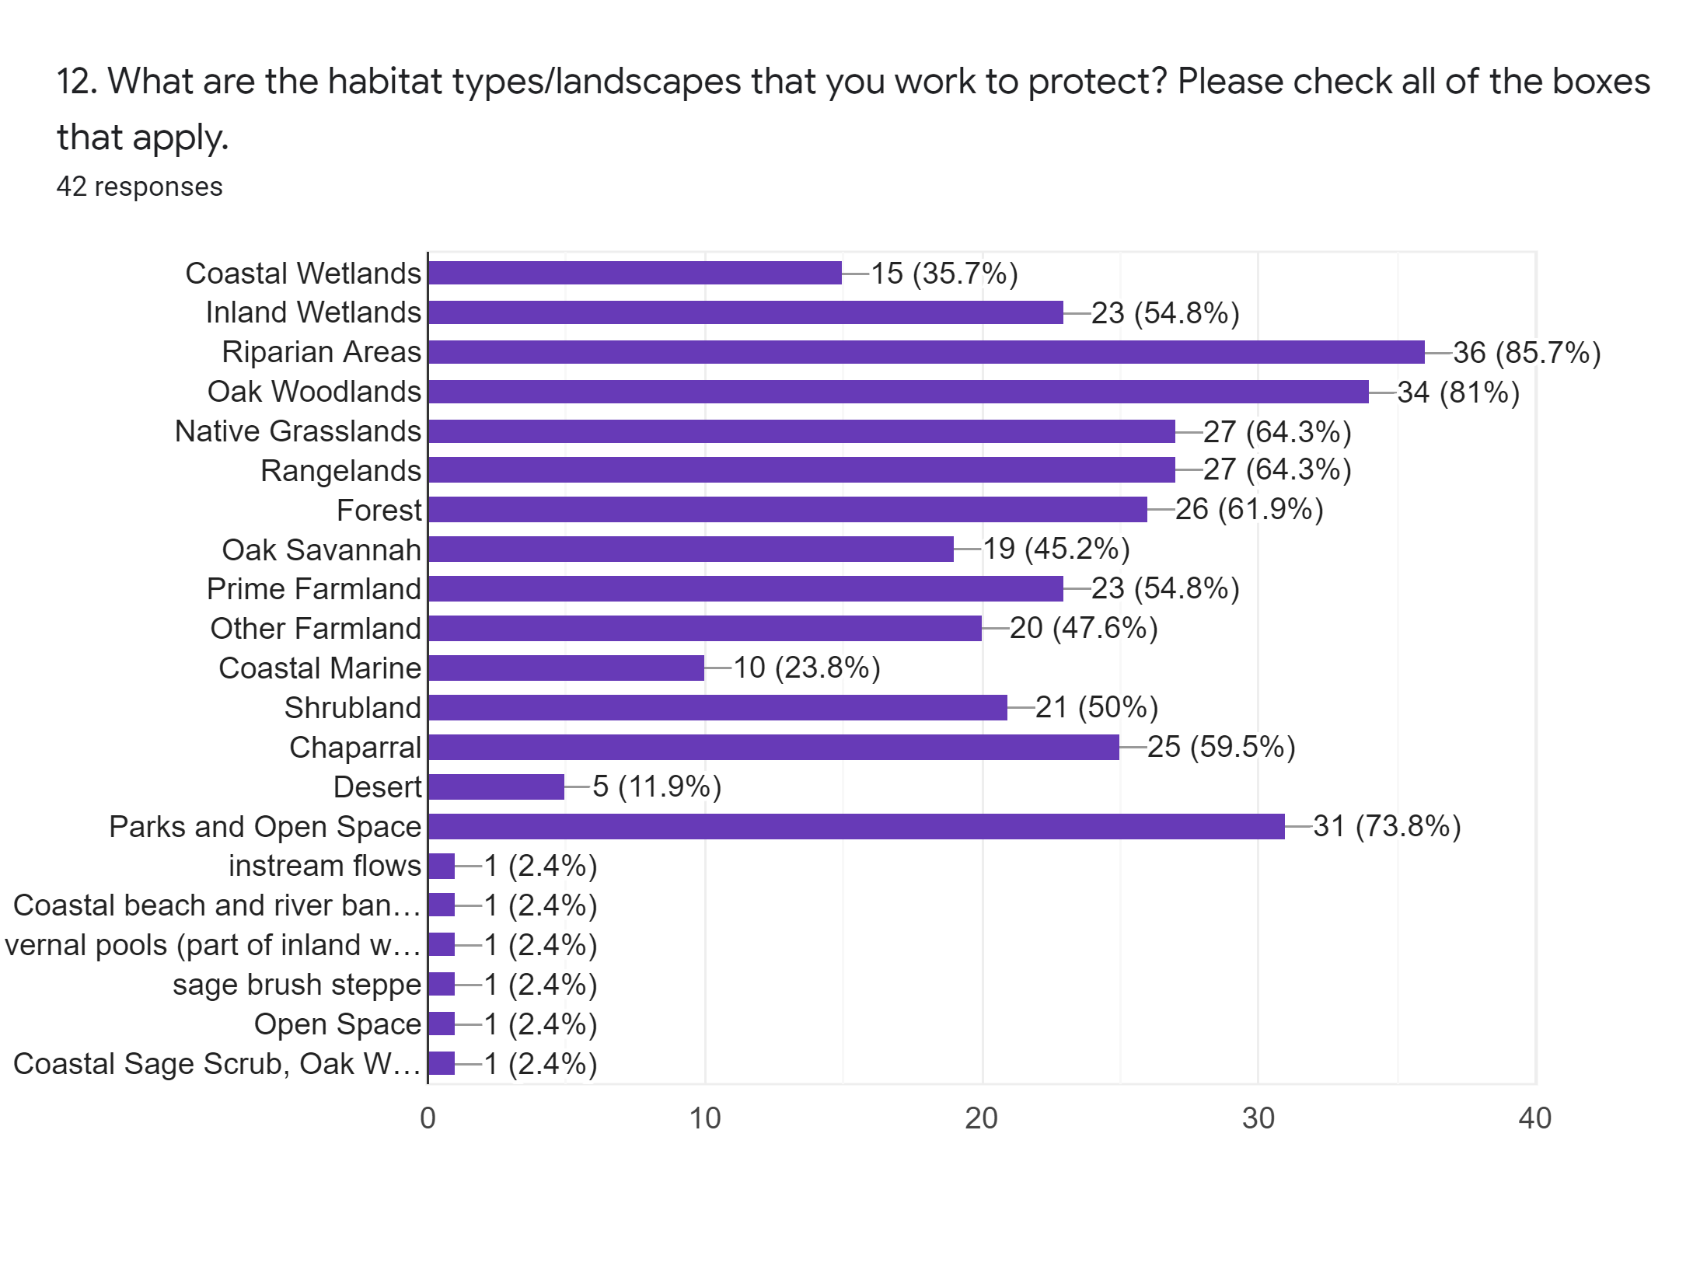
Notes:
The habitat types of the greatest focus are riparian areas (85.7%), Oak woodlands (81%), Parks and Open Space (73.8%), Native grasslands and rangelands (64%), Forest (61%), Chapparal (59%), Prime farmland and inland wetlands (each 54%), shrubland (50%), other farmland (46%), Coastal wetlands (35.7%) and Coastal Marine (23.8%). Deserts were not as much of a focus (12%) as well as instream flows, coastal beach and river banks, vernal pools, sage brush steppe, and coastal sage scrub, which only got 1 vote each.

Slide 6
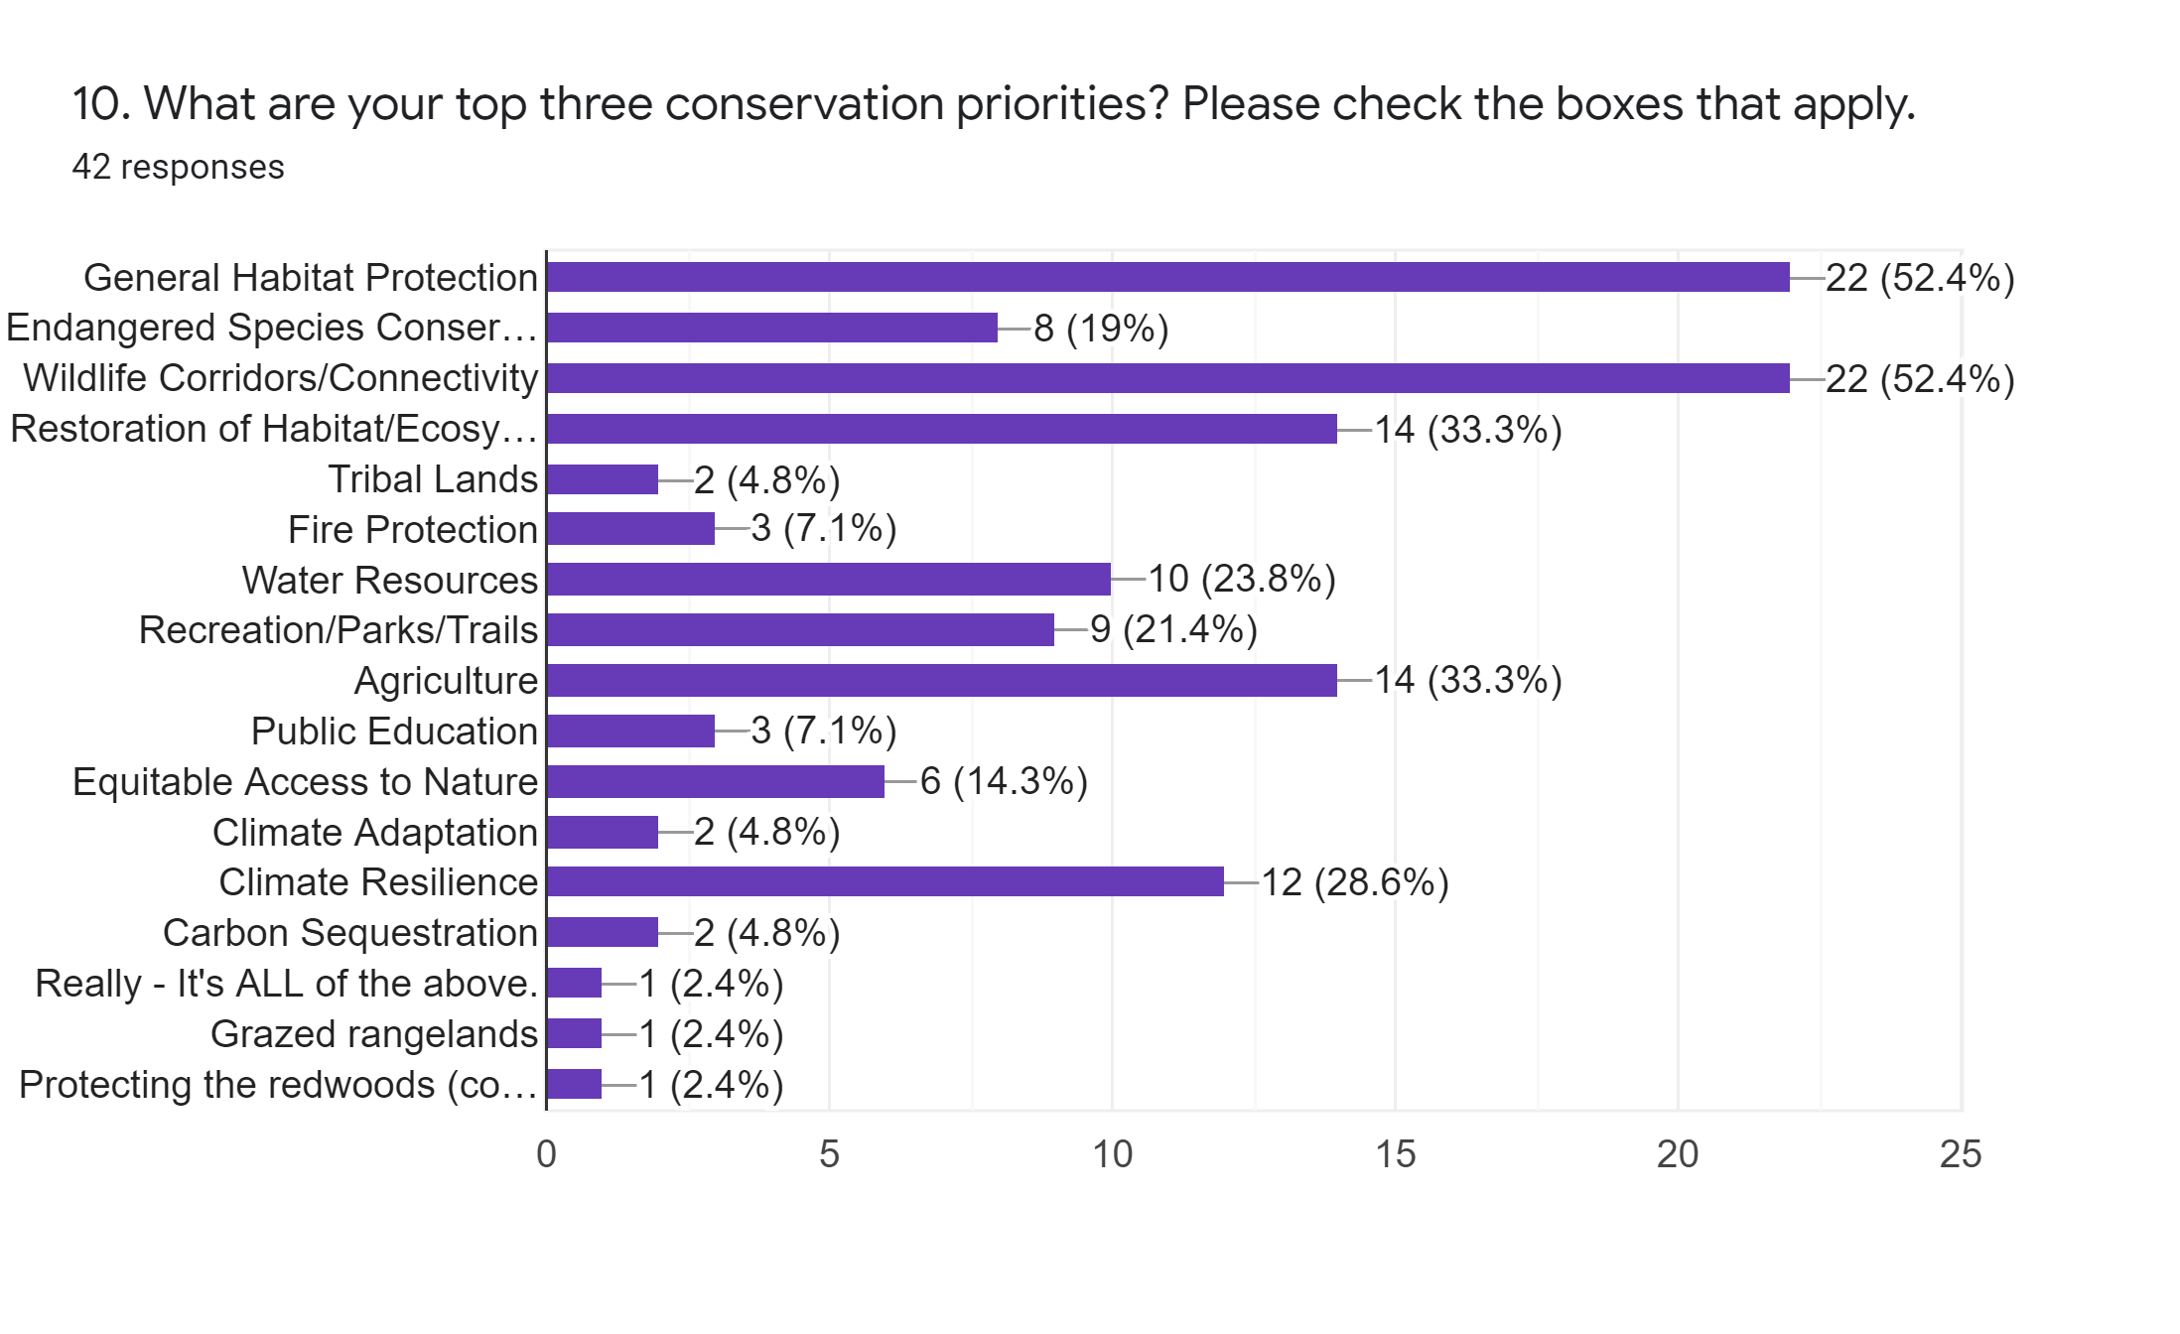
Notes:
Regarding top conservation priorities, the lead vote getters were General Habitat Protection (52.4%) and Wildlife Corridor and Connectivity (52.4%). Close behind were Restoration of Habitat (33.3%), Agriculture (33.3%), Climate Resilience (28.6%), Water Resources (23.8%), and Recreation/Parks/Trails (21.4%). This shows that trusts are doing work very relevant to the Biodiversity Executive Order.

Slide 7
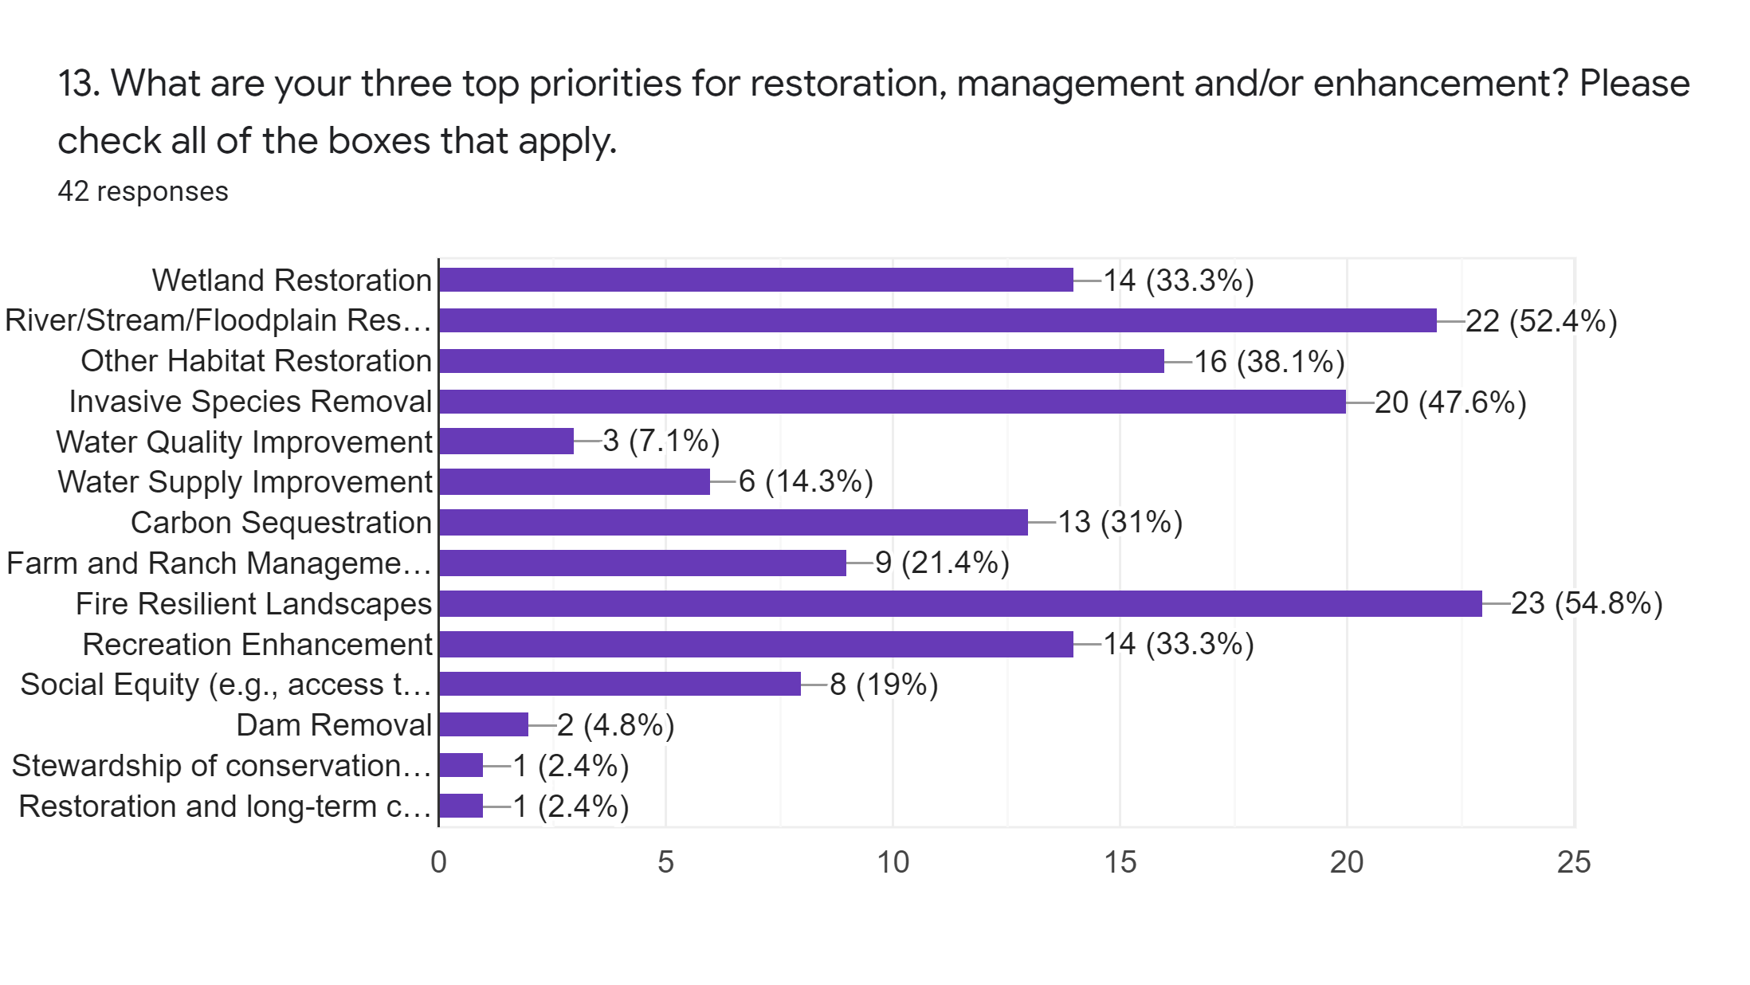
Notes:
For the top restoration, management and/or enhancement priorities, the majority of land trusts are working on fire resilient landscapes and river/stream and floodplain restoration, which line up very closely with where the current focus is on funding from the state. Other priorities were invasive species removal (47%), other habitat restoration (47%), wetland restoration (33%), carbon sequestration (31%), recreation enhancement (33%), and farm and ranch management.

Slide 8
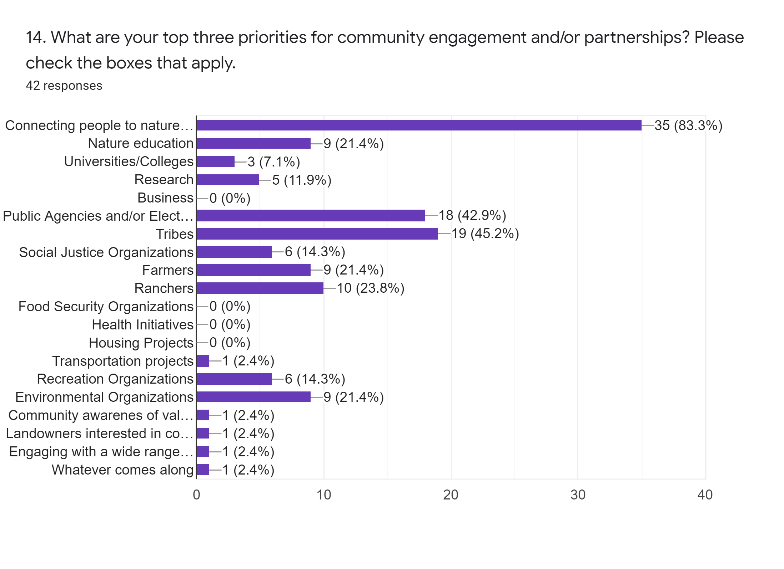
Notes:
For the top priorities for community engagement and/or partnerships, more than 80% of the land trusts ae working to connect people to nature and about one-fifth are conducting nature education. Nearly half the land trusts are working with public agencies and/or elected officials and with tribes. Just under one-quarter of the land trusts are working with farmers and ranchers. One-fifth of the land trusts are working with environmental organizations and about 14% are working with recreation organizations or social justice organizations.

Slide 9
Comment Letters
There are existing regional workgroups in which many land trusts are engaging.
CCLT is going to prepare comment letter template that we will share with membership for 9/2 deadline.
We will use survey data
Provide guidance on what specifics you should include (e.g.., existing or planned projects).
Focus on how Land Trusts are critical to meet 30 by 30 and Climate Smart Land Goals & how state can help Land Trusts meet these goals.

Slide 10
Questions? kdelfino@earth-advocacy.com

